Slide 1
TOPIC
Prevention of Dialysis by early stage risk assessment using data analytics.

Slide 2
INTRODUCTION
A global health problem which is steadily growing is Chronic kidney disease(CKD).Having CKD means that your kidneys have been damaged, usually slowly over a long period of time (months or years).
Undiagnosed CKD can be identified, predicting the likelihood that patients will develop chronic disease, and present patient-specific prevention interventions by providing Diet plan.

Slide 3
DATASET:
Parameters considered for risk assessment are :
Diabetes (HbA1c)
Hypertension(BP)
IHD(Ischaemic Heart disease)
COPD(chronic obstructive Pulmonary/lung disease)
smoking
alcohol intake
cholesterol levels
recurrent UTI.

Slide 4
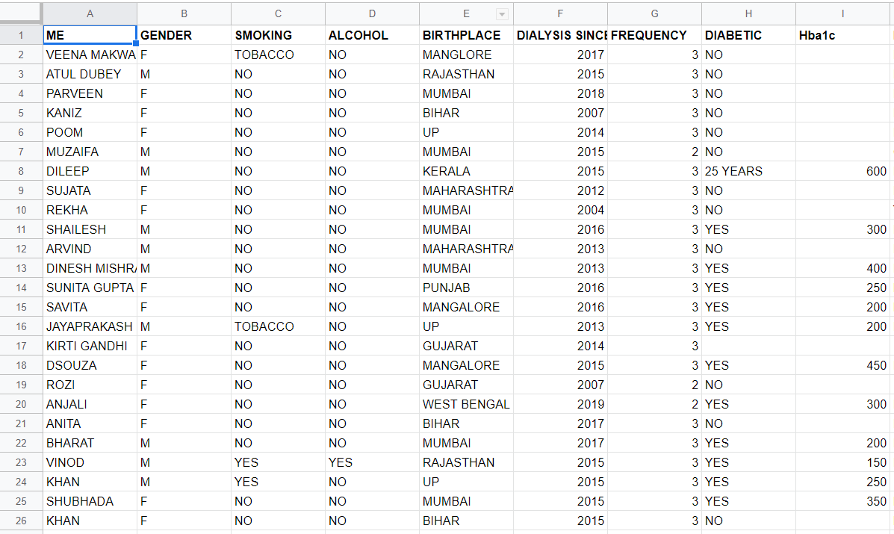

Slide 5
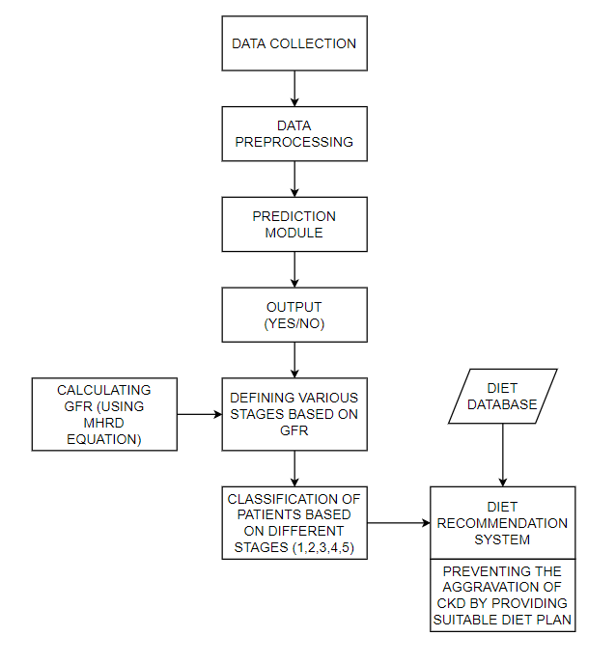
BLOCK DIAGRAM

Slide 6
PROPOSED SYSTEM
Input
The Kidney failure risk analyzer needs the user to provide their Age , gender and the Creatinine value as inputs to check their kidney condition.The users can get the creatinine value from their family doctor,which in turn is used for predicting the CKD stage
Prediction of CKD stages
Based on the inputs provided by the user ,the analyzer calculates the GFR value using the MHRD equation.Then the user is classified into stages from 1-5 based on this GFR value.

Slide 7
Prediction of CKD stages
Based on the inputs provided by the user ,the analyzer calculates the GFR value using the MHRD equation.Then the user is classified into stages from 1-5 based on this GFR value.

Slide 8
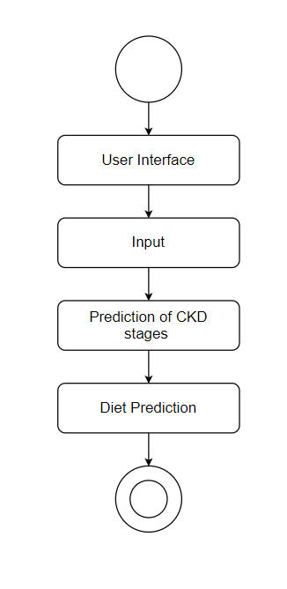

Slide 9
OBJECTIVES
To build a system which provides the CKD patients with more information to help them better understand the diagnosis.
To provide assistance to the doctors to make patients better understand the severity of the damage.
To slow down the further damage of kidneys through healthy dietary plan.

Slide 10
METHODOLOGY
Data Collection
Data Pre-Processing
Prediction Module
Defining various stages based on GFR
Calculating GFR using MDRD Equation
Classification based on different stages
Diet Database and Recommendation

Slide 11
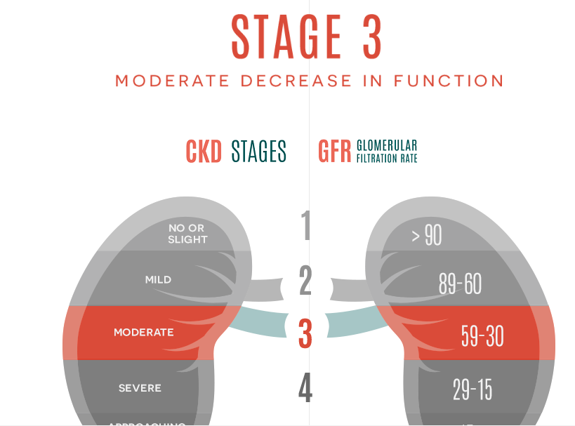
RESULTS

Slide 12
In the above test case(Fig ),we have male patient details / parameters which is fed to the kidney failure risk analyzer which inturn calculates the GFR value and classifies the respective patient to Stage 3 of CKD .
We have visualized it for the patient to understand, along with it some additional information about their respective stage , symptoms, medication and most importantly a diet plan is provided to help slow down the further damage of kidney and reduce the chances of undergoing a dialysis or kidney transplant.

Slide 13
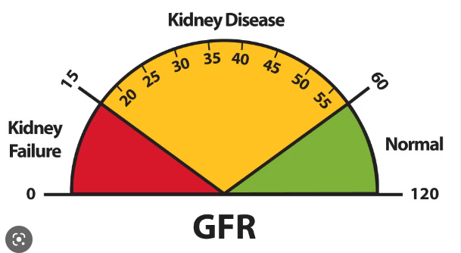

Slide 14
CONCLUSION
With the increase in number of CKD patients globally, there is a demand for developing a system that will not only predict whether the patients will have CKD or not but also will provide a suitable preventive measures.This can be prevented only at an early stages.
Hence in this work we have implemented a model that will prevent the loss of kidney functioning when detected at an early stages.
The proposed model will classify the kidney functioning in 5 different stages and predict the suitable diet plan for different stages.
This model is built by using algorithms of survival analysis like KM model and Cox Proportional Hazard model.

Slide 15
REFERENCES
[1] Navdeep Tangri, MD, PhD, FRCPC”Multinational Assessment of Accuracy of Equations for Predicting Risk of Kidney Failure A Meta-analysis”JAMA January 12, 2016 Volume 315, Number 2.
[2] M.P.N.M. Wickramasinghe, D.M. Perera, and K.A.D.C.P. Kahandawaarachchi,”Dietary prediction for patients with Chronic Kidney Disease (CKD) by considering blood potassium level using machine learning algorithms,” in 2017 IEEE Life Sciences Conference (LSC), Sydney, NSW, Australia, 2017.
[3] Akash Maurya,”Chronic kidney disease prediction and Recommendation of Suitable Diet plan by using Machine Learning” in 2019 International Conference on Nascent Technologies in Engineering (ICNTE 2019)
[4] https://www.niddk.nih.gov/health-information
[5] T. Di Noia, V. C. Ostuni, F. Pesce, G. Binetti, D. Naso,F. P. Schena, and E. Di Sciascio. ”An end stage kidney disease predictor based on an artificial neural networks ensemble”, Expert Systems with Applications, vol. 40, pp. 4438–4445, 2013
[6] Soundarapandian P. (2015). UCI Machine Learning Repository [https://archive.ics.uci.edu/ml/datasets/chronickidneydisease].Irvine, CA :UniversityofCalifornia, SchoolofInformationandComputerScience.
[7] https://www.davita.com/education/kidney-disease/stages
[8] https://www.sciencedirect.com/science/article/pii/S2352914818302387

Slide 16
THANK YOU

